Slide 1
Text Analytics using WordCloud and LDA Model

Slide 2
Interest
Someone had analysed US Presidential Election Speech to analyse how the topics have changed over the years
Fairly interesting project
Combines webscrapping and some text analytics and modelling
Small subset of Machine Learning
http://tlfvincent.github.io/2015/10/23/presidential-speech-topics/
Apply similar idea to PM Lee’s GE or NDR speeches

Slide 3
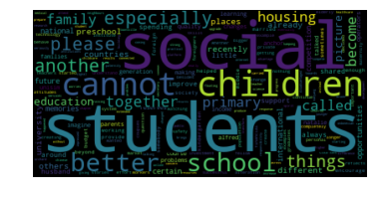
Basic WordCloud – must open in py2
Obtain LHL’s 2012 speech from PMO Office
Limitations
Cannot pick up colloquial language
Cannot pick up sarcasm or words with double meanings
Lose contextual meaning
Improved with LDA Modelling

Slide 4
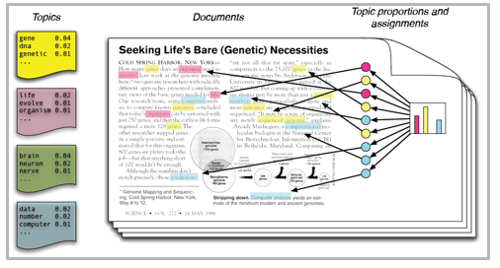
Topic Analysis – LDA Modelling (open in py3)
“Unsupervised” Machine Learning – no preset or particular end goal
Latent Dirichlet allocation

Slide 5
LDA Topic Modelling
End Goal:
Identify topics present in a text object
Derive hidden patterns exhibited by a text corpus (document)
How:
Unsupervised approach to find and observe a bunch of words in large clusters of text
Defn of Topic:
Repeating pattern of co-occurring terms in a corpus (document)
Words that are of the same topic usually are found near each other

Slide 6
Methodology
It Iterates through each word “w” for each document “d” and tries to adjust the current topic – word assignment with a new assignment. A new topic “k” is assigned to word “w” with a probability P which is a product of two probabilities p1 and p2.
For every topic, two probabilities p1 and p2 are calculated. P1 – p(topic t / document d) = the proportion of words in document d that are currently assigned to topic t. P2 – p(word w / topic t) = the proportion of assignments to topic t over all documents that come from this word w.
The current topic – word assignment is updated with a new topic with the probability, product of p1 and p2 . In this step, the model assumes that all the existing word – topic assignments except the current word are correct. This is essentially the probability that topic t generated word w, so it makes sense to adjust the current word’s topic with new probability.
After a number of iterations, a steady state is achieved where the document topic and topic term distributions are fairly good. This is the convergence point of LDA.

Slide 7
Credits
https://www.analyticsvidhya.com/blog/2016/08/beginners-guide-to-topic-modeling-in-python/
http://tlfvincent.github.io/2015/10/23/presidential-speech-topics/

